Slide 1
Introduction to Basic First Aid

Slide 2

Legal Issues Around First Aid
First Aiders must:
  Get permission to help
    Assumed consent if the victim is unresponsive or a young child with no caregiver
  Only give care they are trained to provide
  Continue Care
    Give care until another trained person takes over, too tired to continue, scene becomes unsafe, person no longer needs first aid

Slide 3
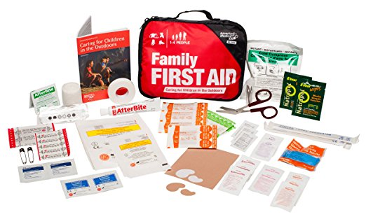
Lowering Risk of Infection
For first aider:
  Wear gloves – do not touch outside of the glove when removing
  Wash your hands
  Use a face mask
For victim:
  First aider uses gloves and a mask
  Use clean/sterile dressings
  Check circulation below the injury before and after applying a bandage
  If blood soaks through, apply more bandages over existing ones
  Monitor open wounds for infection
    Look for redness, swelling, or discharge and get medical attention if infection is suspected

Slide 4

Check, Call, Care
Check
  Scene safe?
  Clues to what happened?
  Is the person responsive?
  Checks ABCs
    Airway – if it is not open, head-tilt/chin lift
    Breathing – watch chest for 5-10 seconds
    Circulation – quickly check for life-threatening bleeding
Call
  If the person is unresponsive or has life-threatening condition call 911
Care
  Care for life-threatening conditions first
  Monitor, keep victim comfortable, put them in the recovery position if necessary

Slide 5
Shock
Life-threatening condition
Look for
  Anxiety, confusion, cool clammy skin, pale skin, weakness, rapid breathing, excessive thirst (do not give them anything to drink), nausea/vomiting, drowsiness or loss of responsiveness
Call 911
Care:
  Treat suspected cause of shock
  Provide continued care

Slide 6
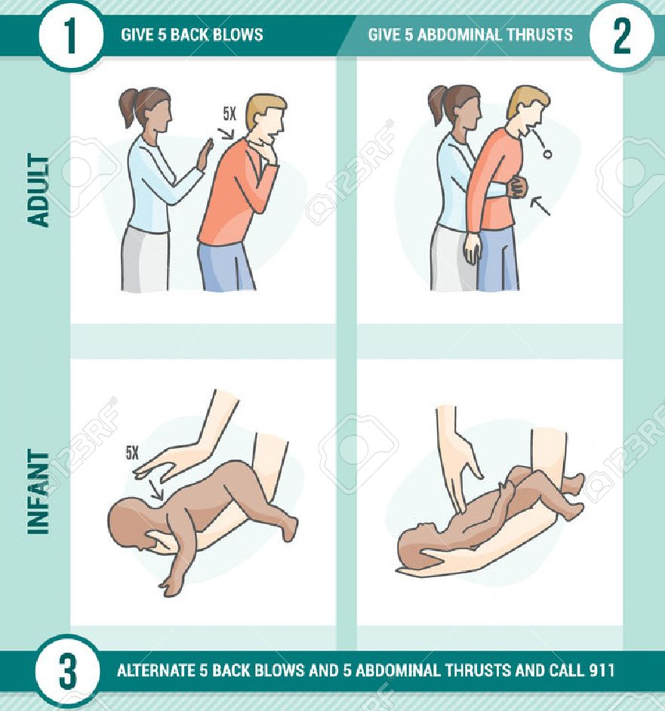
Choking
If the person is able to cough/speak encourage them to cough
If the airway becomes blocked
  Call 911
  Alternate between two of the following
    Back blows – support front of victim and give 5 firm back blows between shoulder blades
    Abdominal thrusts – place your fist above the bellybutton and give 5 quick inward and upward thrusts
    Chest thrusts – place your fist in the middle of victim’s chest and pull back quickly 5 times
  If the victim is a baby
    Sit or kneel with baby face down on your forearm and supporting the head, give 5 back blows.
    If the object doesn’t come out flip the baby (making sure to support the head), and use 2 fingers or knuckles to give 5 chest compressions
    Repeat until object is removed or baby becomes unresponsive
  If you are by yourself call 911 and perform abdominal thrusts against an object such as a chair
  If the victim becomes unresponsive, ensure 911 has been called and begin CPR

Slide 7
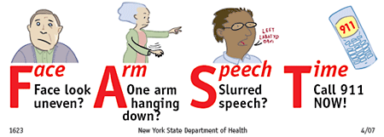
Circulation Emergencies: Stroke
Occurs when blood flow to part of the brain is interrupted
Look for
  Dizziness or confusion, unresponsiveness, loss of bladder or bowl control
  FAST: Face (numbness or weakness – especially on one side), Arm (numbness or weakness – especially on one side), Speech (abnormal, loss, difficulty speaking or understanding others), Time (time is important – call 911 right away)
Have the person rest and note when the signs and symptoms began

Slide 8
Circulation Emergencies: Bleeding
Direct pressure
Call 911 if the bleeding is difficult to stop or control
  Maintain direct pressure when applying a dressing and bandage
  If blood soaks through apply another bandage on top
Internal bleeding
  Look for bruising/pain in injured area, tender, swollen, or hard soft tissues, blood in saliva or vomit, severe thirst, nausea, or vomiting, and/or anxiety
  Call 911 and have victim rest

Slide 9
Cardiopulmonary Resuscitation (CPR)
Used when someone is unresponsive and not breathing
Call 911 and get an AED
If you are alone and the victim is a child or baby, do 5 cycles (2 minutes) of CPR before taking victim with you to call 911 and get an AED
To perform CPR
  Do 30 chest compressions – hands (fingers for baby) in centre of chest. Push deep and steady – 110-120 compressions/minute
  Give 2 breaths – open airway, use barrier device, give just enough air to make chest rise
  If breaths go in, repeat 30 compressions and 2 breaths until another trained person takes over, you are too tired to continue, the scene becomes unsafe, there is an obvious sign of life
  If breaths don’t go in, reposition head and try another breath and look in mouth for object after each set of chest compressions

Slide 10
AED
Dramatically increases chance of survival
Remove victim from water before use
To use
  Open and turn it on – listen to instructions
  Apply pads and follow prompts
  Continue CPR
  Bondi Rescue

Slide 11
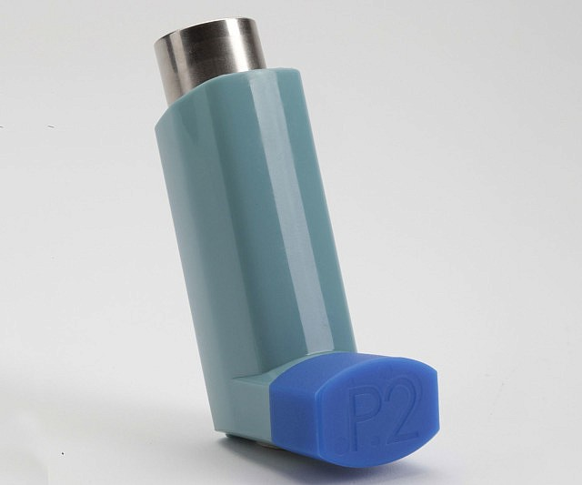
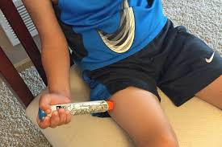
Breathing Emergencies
Asthma - Call 911 if necessary
  Move person away from any triggers
  If available, help them take their medication (inhaler)
    Shake inhaler and remove cap
    Inhale inhaler taking full slow breath
    Cold breath as long as comfortable
Anaphylaxis - Call 911
  If available, help victim use their epinephrine auto-injector
    Remove cap
    Firmly push tip into thigh (should hear a click) and hold for 5-10 seconds
    Rub injection site for 30 seconds
    If condition does not improve within 5 minutes, repeat the dose
    Have victim rest quietly until help arrives

Slide 12
Burns
Call 911 and get an AED if the burn
  Makes it difficult to breathe
  Was caused by chemicals, explosions, or electricity
  Is full thickness, or includes a large amount of broken skin or blisters
  Covers the hands, face, neck, genitals, or a large area
Care
  Cool the area for at least 10 minutes
  Remove jewelry and clothing from burn site (unless it is stuck)
  Cover burn with loose, dry, sterile dressing

Slide 13
Burns Continued
Chemical Burns
  Put on protective equipment
  Brush chemicals of skin and remove clothing with chemicals on them
  Flush with cool water for at least 15 minutes
Electrical Burns
  Make sure electrical current has been turned off
  Keep victim still
  Look for (and treat) two burns – entry and exit points
  Closely monitor ABCs

Slide 14
Impaled Objects
Call 911
Leave object in place
Stabilize object without putting pressure on it
Secure dressings in place

Slide 15
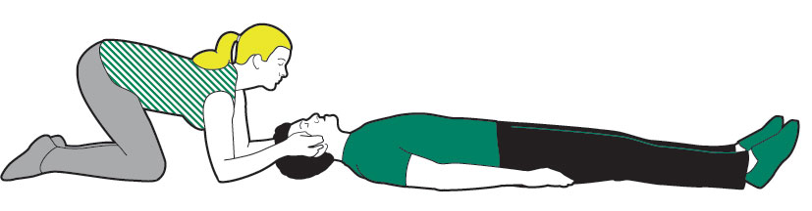
Head, Neck, and Spinal Injuries
Suspect a head, neck, or spinal injury if there is a fall from height, a diving injury, a victim found unresponsive for unknown reasons, strong blow to torso, head, or jaw, or if victim was electrocuted or struck by lightning
Look for
  Severe pain/pressure in head, neck, or back
  Blood or other fluids from ears or nose
  Bruises (around eyes and behind ears)
  Seizures
  Nausea or vomiting
  Unequal pupil size or impaired vision or breathing
  Loss of bladder or bowel control
  Partial or complete loss off movement of a body part
  Changes in behavior, awareness, or responsiveness
  Dizziness/loss of balance
  Weakness, loss of sensation, or tingling
Call 911 and get an AED
Have victim stay as still as possible – if they are unresponsive, support head in position found

Slide 16
Eye Injuries
Call 911 if an object is impaled in or near the eye, if the eye is out of the socket, or if a chemical is in the eye
If there is something in the eye, but not impaling it
  Ask victim to blink
  Gently flush eye with running water
  If object hasn’t been removed get medical attention
If a chemical is in the eye gently flush eye for at least 15 minutes – make sure water is running away from unaffected eye

Slide 17
Bone, Muscle, and Joint Injuries
Call 911 if
  Injury is to pelvis or thigh bone
  Area below injury is numb, cold, pale, or blue
  Bone is protruding through skin
  Cannot safely move victim
Care: RICE
  Rest
  Immobilize
  Cool
  Elevate

Slide 18
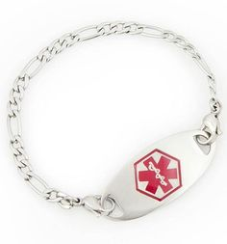
Sudden Medical Emergencies
Diabetic
  If the victim can safely swallow, have them eat sugar
  Call 911 if victim is not fully awake, victim has a seizure, or condition doesn’t improve within 10 minutes of having sugar
Seizures
  Call 911 if you do not know victim’s medical history, the seizure lasts more than a few minutes, the victim has several seizures in a row, or if the victim is unresponsive for an prolonged period
  Protect victim from injury
  Do not hold them down
  Roll victim into recovery position – may be drowsy/disoriented for up to 20 minutes

Slide 19
Any Other Situations You Have Questions About?
Nosebleeds
Knocked out teeth
Concussion
Mental health crisis
Heat-related illnesses
Cold-related illnesses
Poisons
Carbon monoxide poisoning
Insect stings
Animal bites
Tick bites
Fevers

